Slide 1
“Length of Stay” Prediction using ML
Group Project
Jennifer George Frank
Akshita Singhal
Md Akmam Ul Haque
Anandalakshmi Anathara Prasenan
Yashwanth Balaji Krishnamurthy
Siphiwe Hlabano
Healthcare Analytics
Instructor: Rick Audas
MBAN 5570 | April 11th, 2024

Slide 2



Introduction

Slide 3
The Challenge
Top 3 Challenge NS faces
Wait times in ED
Recruitment and retention of healthcare professionals
2.07 hrs
Average ED wait time
April 1, 2021 – March 31, 2022
Access to care
6.17 hrs
Sacred Heart Community Health Centre – Longest WT
0.64 hrs
St. Mary’s Regional hospital – Shortest WT
Challenges
Outdated infrastructure, both physical and digital.
Time to care are impacted by space, overall ED length of stay (LOS) and admitted patient LOS
LOS is not a quality measure but a measure for other measures of quality in the post-acute care setting rehospitalization rates, discharge to community, improvement in function

Slide 4
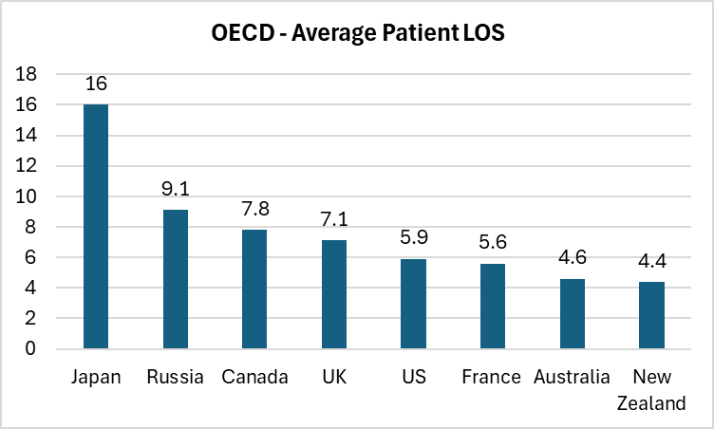
Problem Statement
To evaluate the accuracy and utility of machine learning models that utilize demographic, clinical, and socio-economic data in predicting the Length of Stay (LOS) for patients with chronic conditions.
To determine the extent to which such predictive models can improve resource allocation, patient outcomes, and cost efficiency in healthcare settings.

Slide 5
Dataset

Slide 6
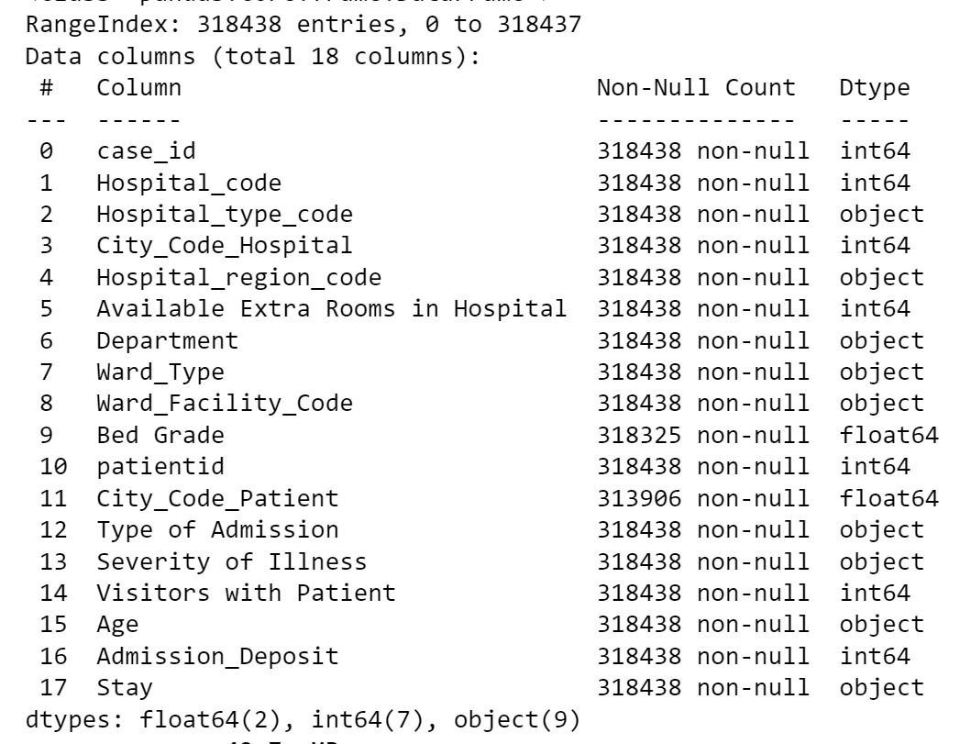
DATA SOURCE
Dataset | Description
Main Data | Contains records of hospital stays with patient demographics, clinical information, and the length of stay.
Sample Submission | Illustrates the expected submission format for the machine learning model predictions, linking case IDs to their predicted length of stay.
Data Dictionary | Provides detailed definitions and descriptions for each field in the dataset, aiding in the understanding and contextual analysis of the data.

Slide 7
DATA FIELDS
Category | Field | Description
Patient Demographics | Age | Age group of the patient, crucial for demographic analysis affecting hospital stay duration.
Hospital Information | Hospital_code | Unique code for the hospital.
 | Hospital_type_code | Code representing the type of hospital.
 | City_Code_Hospital | Numerical code for the city the hospital is located in.
 | Hospital_region_code | Code for the region of the hospital.
Clinical Details | Available Extra Rooms in Hospital | Number of extra rooms available in the hospital.
 | Department | Department overseeing the patient's case.
 | Ward_Type | Type of ward where the patient is staying.

Slide 8
DATA FIELDS
Category | Field | Description
 | Ward_Facility_Code | Code representing the facilities available in the ward.
 | Bed Grade | Quality/condition of the bed in the ward.
 | Type of Admission | Categorizes the admission type (Emergency, Urgent, Trauma, etc.).
 | Severity of Illness | Severity of the patient's illness at the time of admission.
Treatment Specifics | Visitors with Patient | Number of visitors accompanying the patient, indicating support level.
Case Outcome | Stay | Duration of the hospital stay, the target variable for prediction.
Socio-economic Status | City_Code_Patient | Numerical code representing the patient's city, potentially indicating socio-economic status.
 | Admission_Deposit | Deposit amount at admission, acting as a proxy for economic status.

Slide 9
EDA

Slide 10
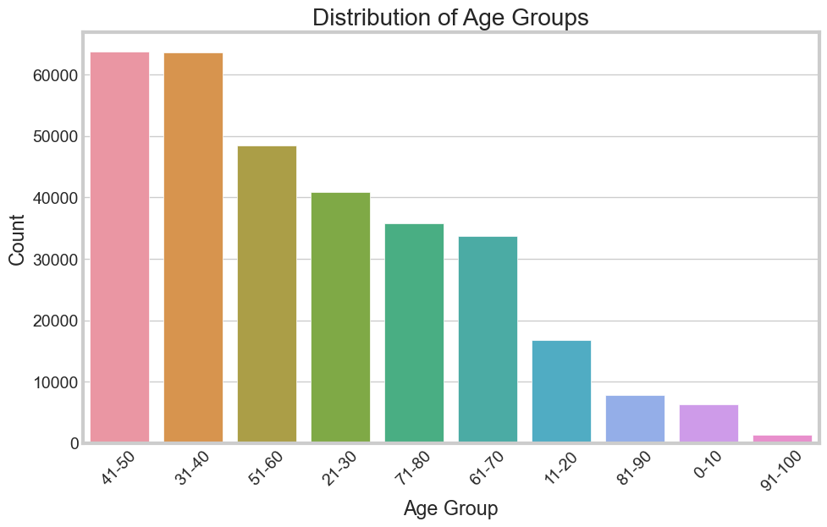
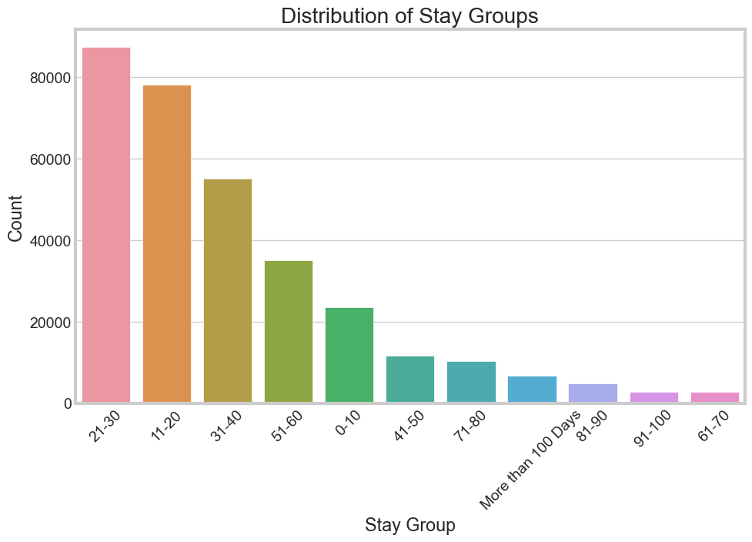
EDA
The bar graph displays the distribution of various age groups, showing that the 31-40 and 41-50 age ranges have the highest counts.
This bar chart shows counts of different stay durations, with stays of 21-30 and 11-20 days being the most common among the groups presented.

Slide 11
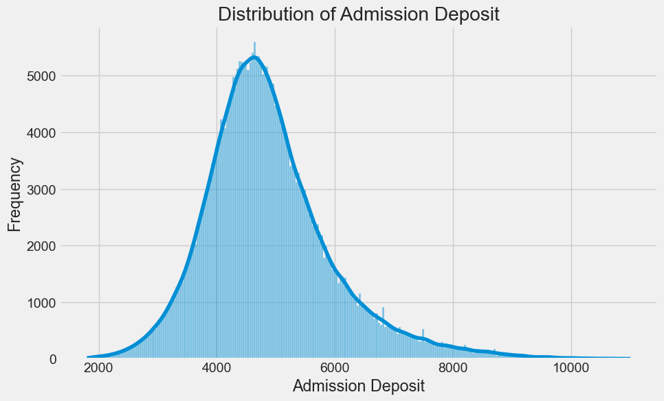
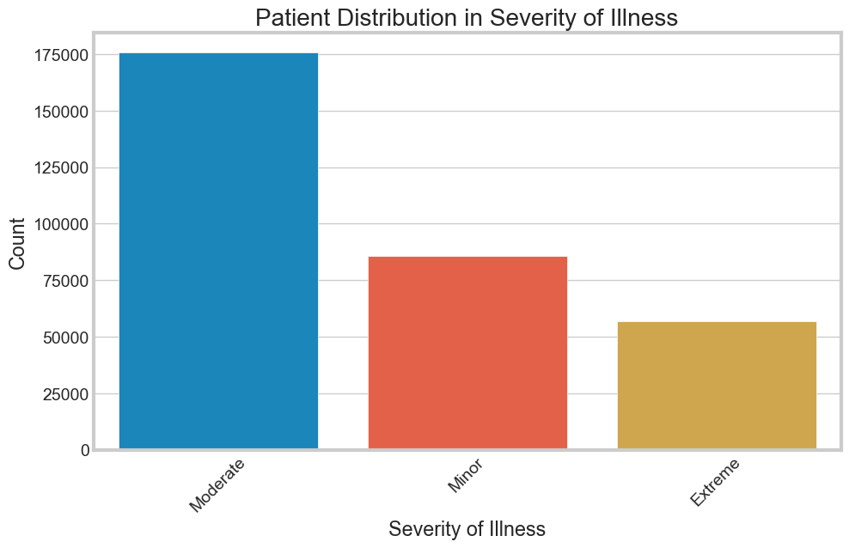
EDA
The histogram with a kernel density estimate shows a distribution of admission deposits, peaking around 5,000 with a right-skewed distribution.
The bar chart illustrates patient counts categorized by severity of illness, showing the majority have moderate illness, followed by minor, with extreme cases being the least frequent.

Slide 12
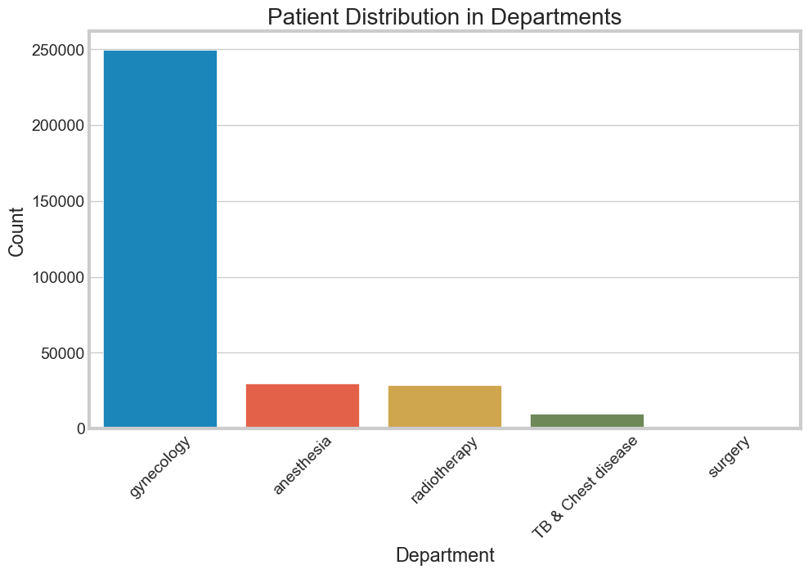
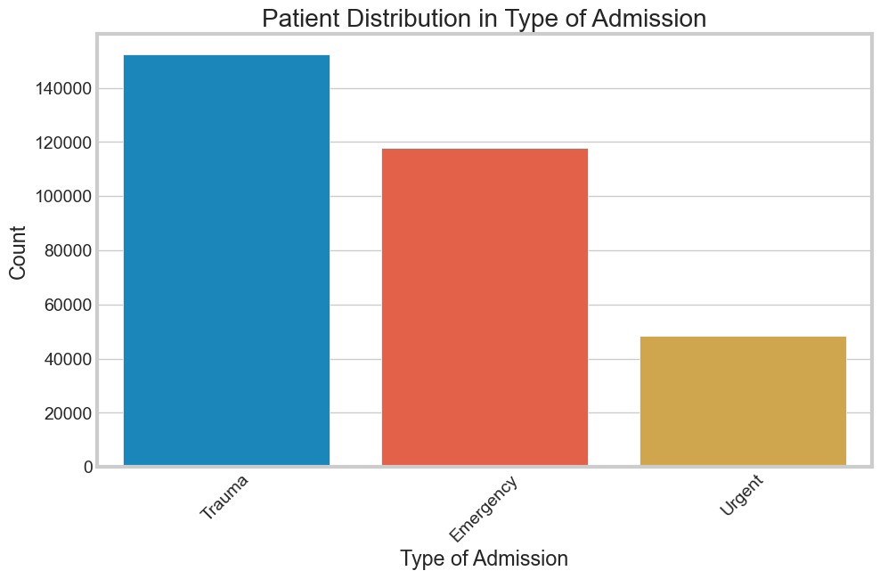
EDA
The bar chart represents the number of patients in various hospital departments, with gynecology having the highest count, followed by much smaller numbers in other departments.
The bar chart shows patient admissions by type, with trauma being the most common, followed by emergency and urgent admissions, in descending order of count.

Slide 13
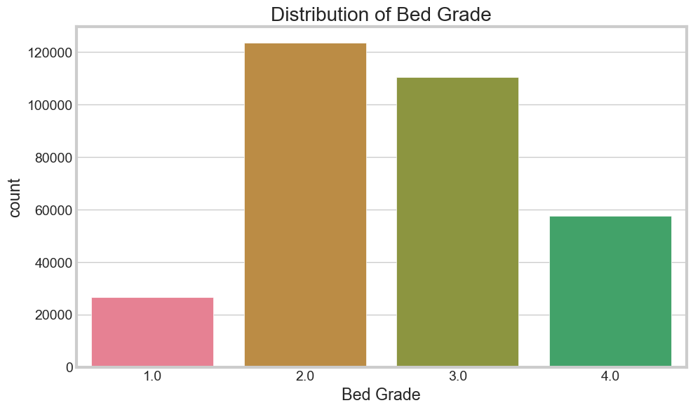
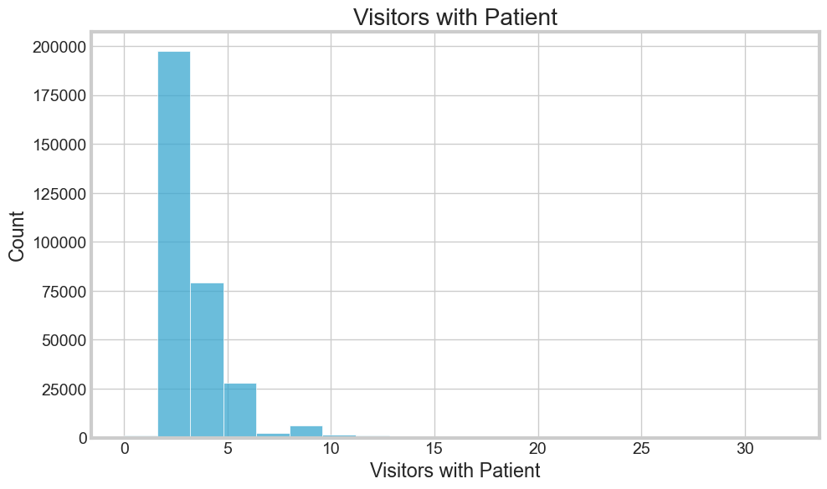
EDA

Slide 14
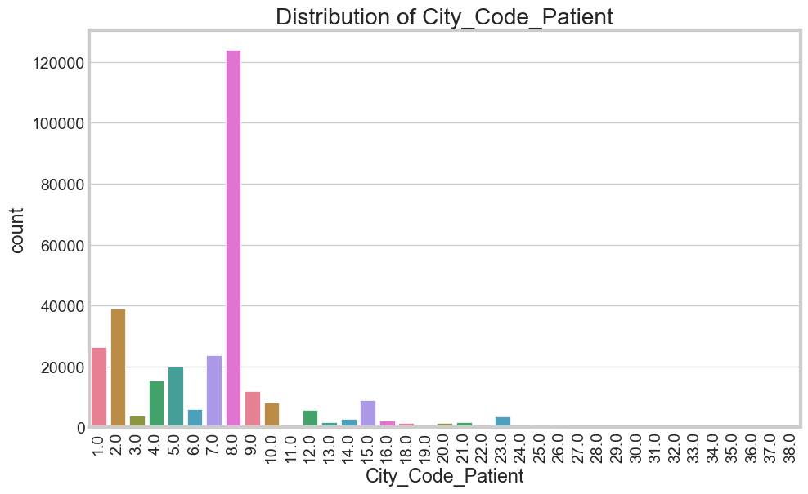
EDA

Slide 15
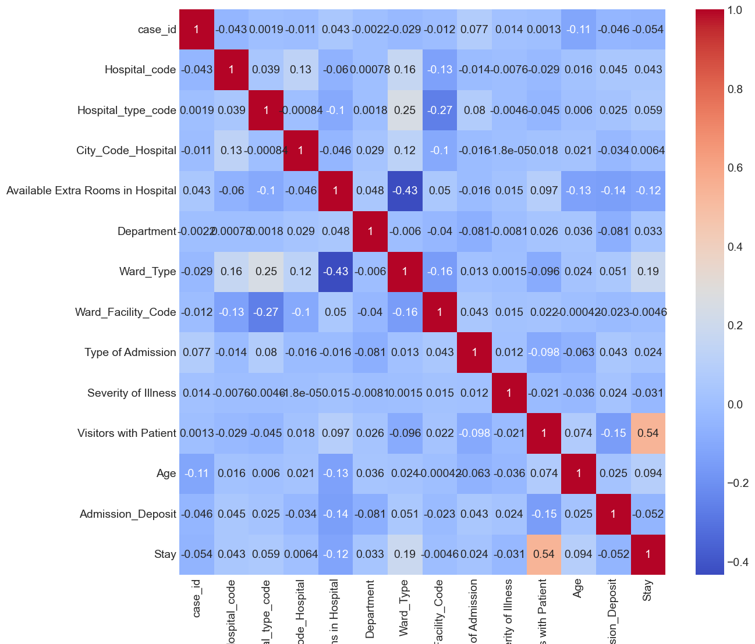
Correlation
Highest Correlation with the Target Variable Stay
Target Variable

Slide 16
MODEL DEPLOYMENT & RESULT

Slide 17
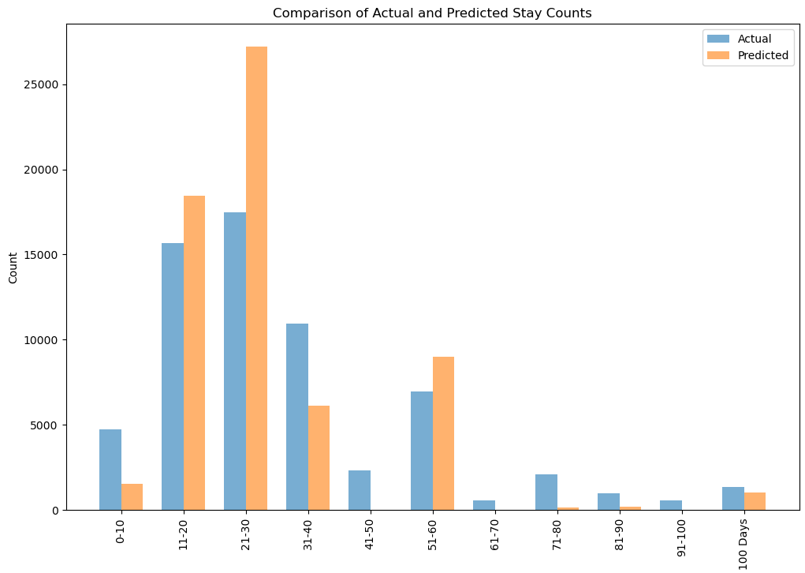
Model Deployment & Result
Model Selection
Random Forest algorithm was selected and applied on the model
Can handle a complex dataset with many features without significant feature engineering
Random Forest works well with both categorical and numerical data

Slide 18
Proposed Solutions
Patient Scheduling
Leverage the model's predictions to optimize patient scheduling and bed management, especially for short and medium-length stays, which comprise the bulk of hospital cases.
Resource Allocation
Utilize the model's strong predictions for short-term stays to allocate resources efficiently for the majority of cases. This can help in reducing unnecessary expenditures and improving patient throughput.
Staffing Optimization
Align staffing levels with predicted patient stays to ensure adequate care without overstaffing, particularly for the predicted shorter stays where the model is most accurate.

Slide 19

Strategic Planning
Preventative Measures
Analyze the patterns leading to longer hospital stays and develop targeted preventative care plans to reduce these extended durations where possible.
Port-Discharge Support
For cases predicted to have longer stays, prepare post-discharge support programs in advance to ensure continuity of care and reduce readmission rates.

Slide 20
Key Performance Indicators

Slide 21
KPIs
This involves ensuring that patients are discharged at the appropriate time without unnecessary delays, contributing to better hospital flow and availability of beds. The U.S. national average 30-day readmission rate for heart failure patients is about 21-22%
Discharge Effectiveness
A significant measure of the effectiveness of hospital care and discharge planning. The average readmission rate in the U.S. is around 14.5%, though it can vary depending on the state and the hospital's patient population and level of care.
Readmission Rates
These are measured using the HCAHPS scores, which are a national standard for assessing patient satisfaction. These scores are derived from surveys distributed to a random sample of discharged patients and include various aspects of the hospital experience.
Patient Satisfaction Score
The discharge timeline refers to how quickly and efficiently a patient is discharged once they're ready. According to a study, efficient discharge processes might target an average of less than 2 hours from decision to discharge to actual departure for straightforward cases.
Discharge Timeline
Efficient utilization of resources like hospital beds and staff time is crucial for operational efficiency and cost control. Optimal occupancy rates are often considered to be around 75-85%, allowing for enough flexibility to accommodate fluctuations in demand.
Resource Utilization

Slide 22
Limitations

Slide 23
Implementation Challenges
01
Data Privacy & Security
Enforce strict compliance with HIPAA & GDPR through encryption and strict access controls.
Seamlessly merge predictive models with hospital systems in partnership with IT.
02
System Integration
03
Clinician Engagement
Earn trust with model accuracy demonstrations, involve in development, and support usage.
Continuously evolve models with new data, maintaining accuracy and clinical relevance.
04
Model Updates
Collaborative Approach
Foster stakeholder collaboration, focused on enhancing care with predictive insights.
05

Slide 24

LIMITATIONS OF THE MODEL
Clinical Variables:
Include key health details like main diagnosis, comorbidities, treatment specifics, current medications, and hospitalization history.
Demographic Variables:
Capture patient demographics such as gender, socioeconomic status, insurance, ethnicity, and marital status for health outcome correlations.
Socio-Economic Variables:
Consider employment, living conditions, and social support as factors influencing recovery.
Hospital/System-Level Variables:
Account for operational metrics like staff-to-patient ratios, occupancy rates, and facility quality that affect patient care.
Time-Related Variables:
Note the role of seasonality and precise admission/discharge timings in stay length.
Outcome Variables:
Track readmission rates, patient satisfaction, and post-discharge health to measure care effectiveness.

Slide 25


THANK YOU

Slide 26
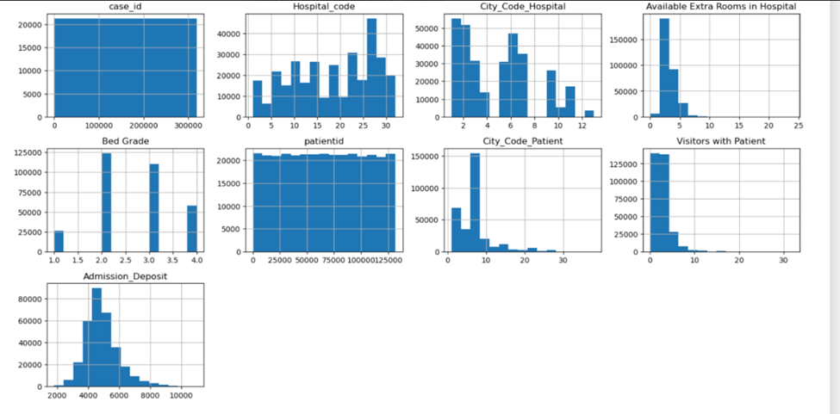
EDA

Slide 27
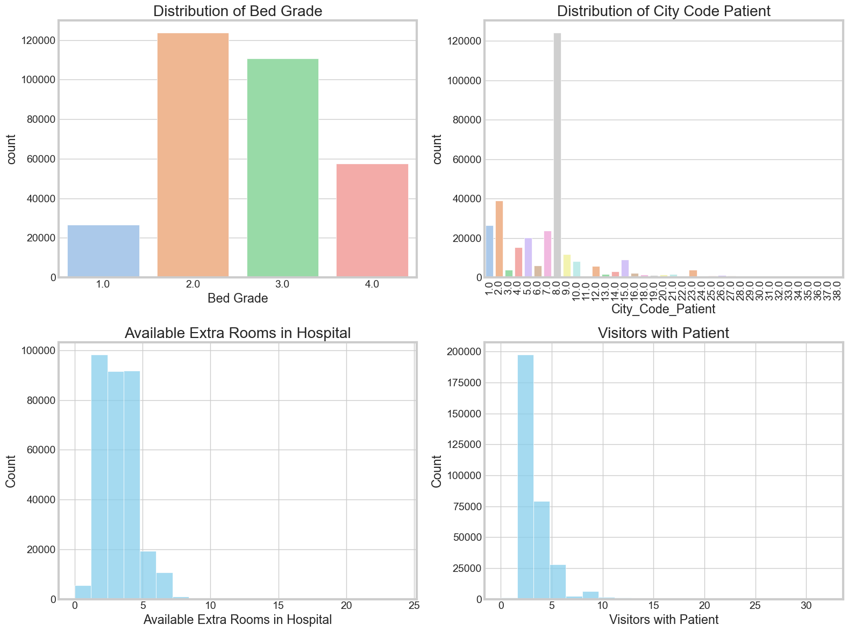
EDA

Slide 28
EDA
Bed Grade: Most patients are in middle-grade beds, suggesting standard bed quality and availability.
City_Code_Patient: Indicates most patients come from certain areas, which might reflect where the hospital services are most used.
Available Extra Rooms: Hospitals typically have a few extra rooms, pointing to a consistent occupancy rate.
Visitors with Patient: Usually, patients have a small number of visitors, hinting at the size of the support network.

Slide 29
Conclusion

